Slide 1

3.4 Bus Interconnection
A bus is a shared transmission medium.
A Bus is a communication pathway connecting two or more devices.
A bus consists of multiple communication pathways, or lines, often grouped. A System Bus connects major computer components.
A number of line/channel in one bus, each capable of carrying one bit.
Over time, a sequence of binary digits can be transmitted over a single line.
Taken together, several lines of a bus can be used to transmit binary data simultaneously (in parallel).
e.g. 32 bit data bus is 32 separate single bit channels.
For example, an 8-bit unit of data can be transmitted over eight bus lines.
Clock
Cycles

Slide 2
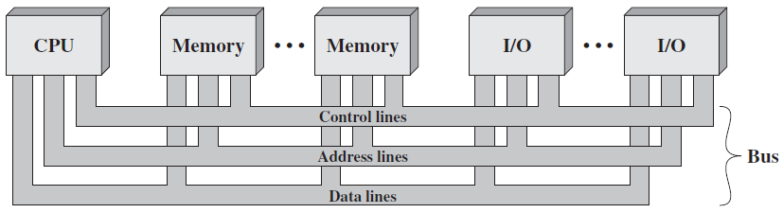
Types of Buses
A system bus consists typically, of from about fifty to hundreds of separate lines.
Each line is assigned a particular meaning or function.
The bus lines can be classified into three groups:
1) Address lines (bus) 2) Data lines (bus) 3) Control lines (bus)
In addition, there may be power distribution lines to attached module.
Two way
Communication;
Read & Write

Slide 3
1. Data Bus
The data lines provide a path for moving data among system modules.
These lines, collectively, are called the data bus.
The data bus may consist of 32, 64, 128 or even more separate lines.
Each line can carry only one bit at a time, the number of lines determine how many bits can be transferred at a time.
The number of these data lines are called the width of the data bus.
The width of the data bus determines the overall system performance.
For example, if the data bus is 32 bits wide and each instruction is 64 bits long, then the processor must access the memory module twice during each instruction cycle. (e.g. two fetch operations in each line)

Slide 4
2. Address Bus
The address lines are used to designate the source or destination of the data on the data bus.
If the processor wishes to read a word (8, 16 or 32 bits) of data from memory, it puts the address of the desired word on the address lines.
The width of the address bus determines the maximum ‘memory capacity’ of the system. (i.e. more bits mean more memory locations)
E.g. 8080 has 16 bit address bus giving 2^16 = 64k address space.
Furthermore, the address lines are also used to address I/O ports.
The higher-order bits are used to select a particular module on the bus, and the lower-order bits select a memory location or I/O port.

Slide 5
3. Control Bus
The control lines are used to control the access to and the use of the data and address lines.
Because data and address lines are shared by all components, there must be a means of controlling their use.
Control signals transmit both command and timing information among system modules. (Control Unit)
Timing signals indicate the validity of data and address information.
Command signals specify operations to be performed.
Typical control line signals are given in the next slide.

Slide 6
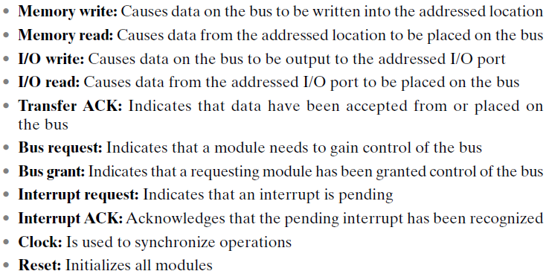
Control Line Signals

Slide 7
Limitations of Bus Design
A bus is a shared transmission medium.
Multiple devices connect to the bus, and a signal transmitted by any one device is available for reception by all other devices attached to the bus.
If two devices transmit during the same time period, their signals will overlap and will become garbled (Make false by subtract or addition).
Thus, only one device at a time can successfully transmit.
We need to set up rules so that only one device can take control of the bus at a time.

Slide 8
Bus Operation Explained
If one module wishes to send data to another, it must do two things:
Obtain the use of the bus, using ‘bus request’ control signal.
Transfer data via the bus, using memory write or I/O write signal.
If one module wishes to request data from another module, it must:
Obtain the use of the bus, using ‘bus request’ control signal.
Transfer a request to the other module over the appropriate control and address lines, using memory read or I/O read control signal.
It must then wait for the second module to send the data.

Slide 9
Single-Bus Problems
If a great number of devices are connected to a single bus, performance will suffer. There are two main causes:
In general, the more devices attached to the bus, the greater the bus length and hence the greater the propagation delay.
Delay in co-ordination of bus use can adversely affect performance.
The bus may become a bottleneck as the aggregate data transfer demand approaches the capacity of the bus.
This problem can be countered to some extent by increasing the data rate that the bus can carry and by using wider buses.
Solution: Instead of a single –bus, use multiple buses in a hierarchy.

Slide 10
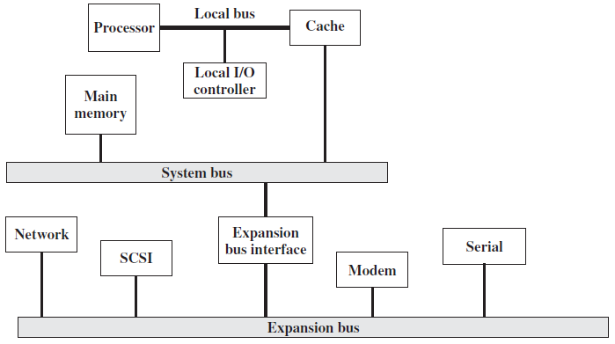
Traditional Bus Architecture
Break

Slide 11
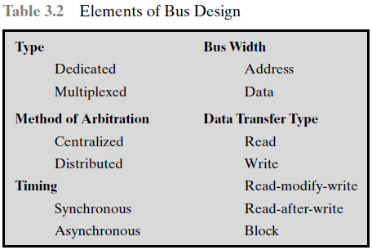
Elements of Bus Design

Slide 12
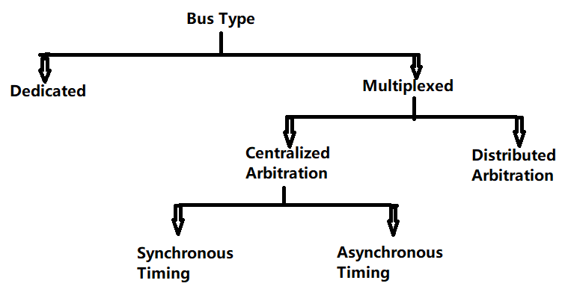
Hierarchy – Elements of Bus Design
Types of buses
Dedicated
Multiplexed
Distributed Arbitration
Centralized Arbitration
Synchronous Timing
Asynchronous Timing.

Slide 13
Bus Types
Bus lines can be separated into two generic types:
Dedicated 2) Multiplexed
Dedicated bus line: is permanently assigned to one physical subset of computer components. E.g. processor and cache.
It refers to the use of multiple buses, each of which connects only a subset of modules.
An example is the use of separate dedicated address and data lines.
The potential advantage of physical dedication is high throughput (data rate), because there is less bus contention.
A disadvantage is the increased size and cost of the system.

Slide 14
Multiplexed Bus
Multiplexed bus line: Using the same set of lines for multiple purposes and multiple modules is known as time multiplexing.
For example, address and data information may be transmitted over the same set of lines using an Address Valid control line.
First place address, each module copies address and determines if it’s the addressed module. The address is removed from the bus and the same bus is used for the subsequent read or write data transfer.
The advantage is the use of fewer lines, which saves space and cost.
Disadvantage, more complex circuitry is needed within each module.
There is a reduction in performance because certain events that share the same line cannot take place in parallel.

Slide 15
Method of Arbitration & Its Types
In multiplexed, more than one module may need control of the bus.
The purpose of arbitration is to designate one device as master/slave.
Because only one unit can successfully transmit over the bus, some method of arbitration is needed (to gain control of the bus).
The two arbitration methods can be classified as:
Centralized arbitration (e.g. CPU) 2) Distributed arbitration
Centralized arbitration: a single hardware device, called an arbiter or bus controller, is responsible for allocating time on the bus. CPU.
Distributed arbitration: there is no central controller. Rather, each module contains access control logic and the modules act together to share the bus. (e.g. they sense if line is available or not)

Slide 16
Bus Timing & Its Types
In centralized arbitration, each device is allocated time on the bus.
Timing refers to the way in which events are coordinated on the bus.
Buses use two types of timing:
Synchronous timing 2) Asynchronous timing
Synchronous timing: The occurrence of events on the bus is determined by a clock. It uses ‘Time multiplexing’ technique.
It is simpler to implement and test, however it is less flexible (fixed Cl)
Asynchronous timing: the occurrence of one event on a bus follows and depends on the occurrence of a previous event.
Advantage, a mixture of slow and fast devices, can share a bus.

Slide 17
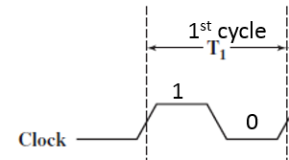
Timing of Synchronous Bus Operation
With Synchronous bus timing
Events determined by clock signals
Control Bus includes clock line
A single 1-0 is a bus/clock cycle, ‘time slot’.
All devices can read clock line
Usually sync on leading edge
Usually a single cycle for an event
In a simple example, the processor places a memory address on the address line during the first clock cycle, it may assert status symbols.
Once the address lines have stabilized, the processor issues an address enable signal.

Slide 18
See Synchronous Timing Figure (Next Slide)
For read operation, the processor issues a read command at the start of the second cycle.
A memory module recognizes the address and, after a delay of one cycle, places the data on the data lines.
The processor reads the data from the data lines and drops the read signal.
For a write operation, the processor puts the data on the data lines at the start of the second cycle and issues a write command.
The memory module copies the information from the data lines during the third clock cycle.

Slide 19
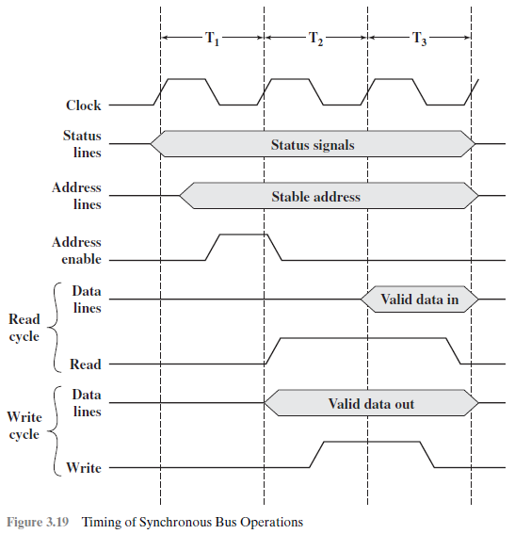
Synchronous Bus Timing
1st cycle
2nd cycle
3rd cycle
1
1
1
0
0
0
(Bus is Busy)
(Bus is Busy)
1st cycle place
Read Operation Sequence:
Place memory address on address line.
Issues ‘address enable’ signal.
Issues ‘read’ single in 2nd cycle.
Memory module recognizes address.
Places data on ‘data lines’, 3rd cycle.
1
Address
enable
Data placed
Read=1
Second cycle
‘Address’ is placed on Address bus.
Write Operation Sequence:
Processor puts ‘data’, 2nd cycle.
Then issues a ‘write’ command.
Memory module copies data
from ‘data lines’ in 3rd cycle.
Data placed
Data copied
Write=1
Write
Enabled

Slide 20
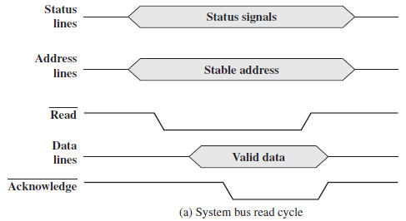
Asynchronous Read Operation
Step-1
(Bus is Busy)
Steps of Asynchronous Read Operation:
The processor places
‘address’ and ‘status’ signals.
2. Then it issues a read command.
3. The memory decodes address
and places the data on the ‘data line’.
4. Memory gives ‘acknowledge’ signal.
5. Master reads data, removes read.
6. Memory drops data and Ack signal.
7. The master removes the address.
Step-2: Read command
Step-3: Places data
Step-4: Ack signal

Slide 21
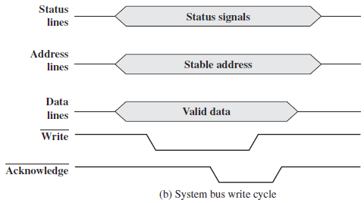
Asynchronous Write Operation
Steps of Asynchronous Write Operation:
Master simultaneously places data,
status and address on respective lines.
2. Then it issues the ‘Write’ command.
3. Memory module copies the data.
4. Then it asserts the acknowledge line.
5. Master drops the write signal.
6. Memory drops the acknowledge signal.

Slide 22
Read for Knowledge
Hardware interrupts are asynchronous and can occur in the middle of instruction execution, requiring additional care in programming. The act of initiating a hardware interrupt is referred to as an interrupt request (IRQ).
Each interrupt has its own interrupt handler. The number of hardware interrupts is limited by the number of interrupt request (IRQ) lines to the processor, but there may be hundreds of different software interrupts. Interrupts are a commonly used technique for computer multitasking, especially in real-time computing. Such a system is said to be interrupt-driven.

Slide 23
Preparatory Questions
What are the two ‘types of interrupts’? Explain.
What are the different ‘classes of interrupts’?
Write down the steps of ‘interrupt handler process’.
List and briefly define two approaches to dealing with ‘multiple interrupts’.
What is the ‘limitation’ of a bus design?
Explain the ‘bus operation’ for a read & write operation, using ‘bus request’ signal.
What is a ‘system bus’? Explain its three constituent buses.
List the different ‘elements of a bus design’. (Bus-type, method of arbitration, timing).

